Slide 1
Introduction to Express Express Router

Slide 2
Objectives
Understand the Express
Implement a web server using the Express framework
Develop a web server that supports a REST API
Use Express router to implement support for the REST API

Slide 3
Express

Slide 4
What is Express?
Express: Fast, unopinionated, minimalist web framework for Node.js (from expressjs.com)
Web application framework that provides a robust set of features
Many third-party middleware to extend functionality
Installing Express:
In your project folder do: npm install express --save

Slide 5
Express Middleware
Middleware provide a lot of plug-in functionality that can be used within your Express application
Example: morgan for logging
var morgan = require(‘morgan’);
app.use(morgan(‘dev’));
Serving static web resources:
app.use(express.static(__dirname + ‘/public’));
Note:__filename and__dirname give you the full path to the file and directory for the current module

Slide 6
A Brief Tour of a Node Module
Examine package.json file
Semantic Versioning
<Major Version>.<Minor Version>.<Patch>
npm install can specify the acceptable package version:
Exact: npm install express@4.x.x
Patch acceptable: npm install express@“~4.x.x”
Minor version acceptable: npm install express@“^4.x.x”

Slide 7
Create a Simple Server using Express

Slide 8
A Simple Server using Express
Create a folder named node-express in the NodeJS folder and move to that folder.
Copy the public folder from node-http to this folder.
At the prompt, type the following to initialize a package.json file in the node-express folder:
npm init

Slide 9
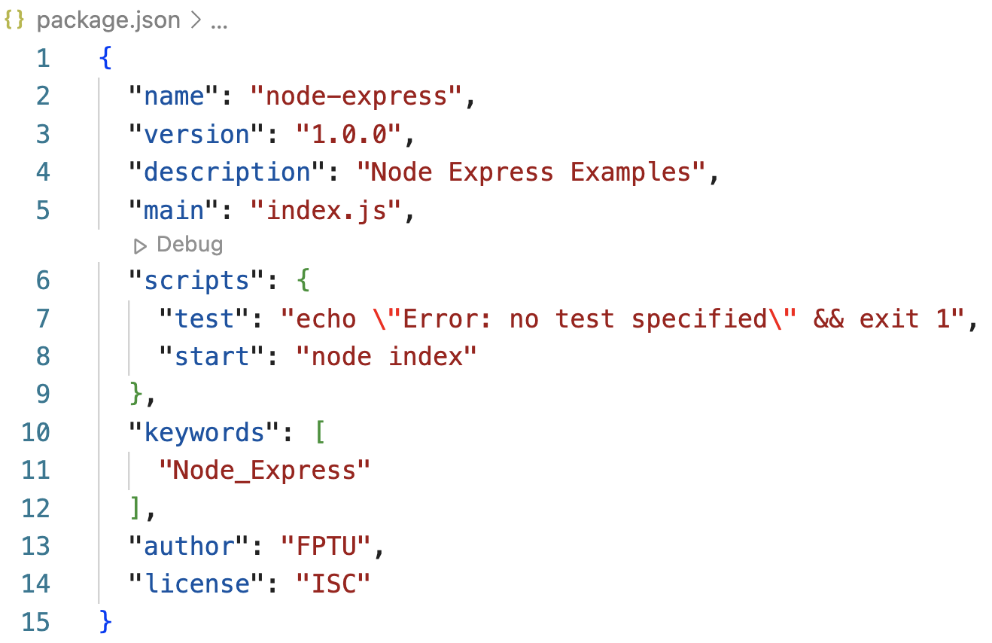
A Simple Server using Express
Accept the standard defaults suggested until you end up with a package.json file containing the following:

Slide 10
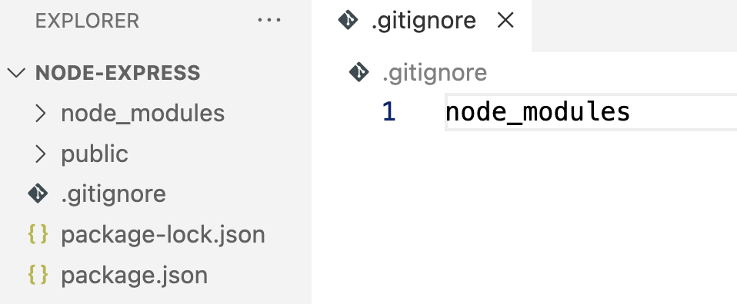
A Simple Server using Express
Then, install the Express framework in the folder by typing the following at the prompt:
Create a file named .gitignore and add the following to it:
npm install express@4.18.1 --save
node_modules

Slide 11
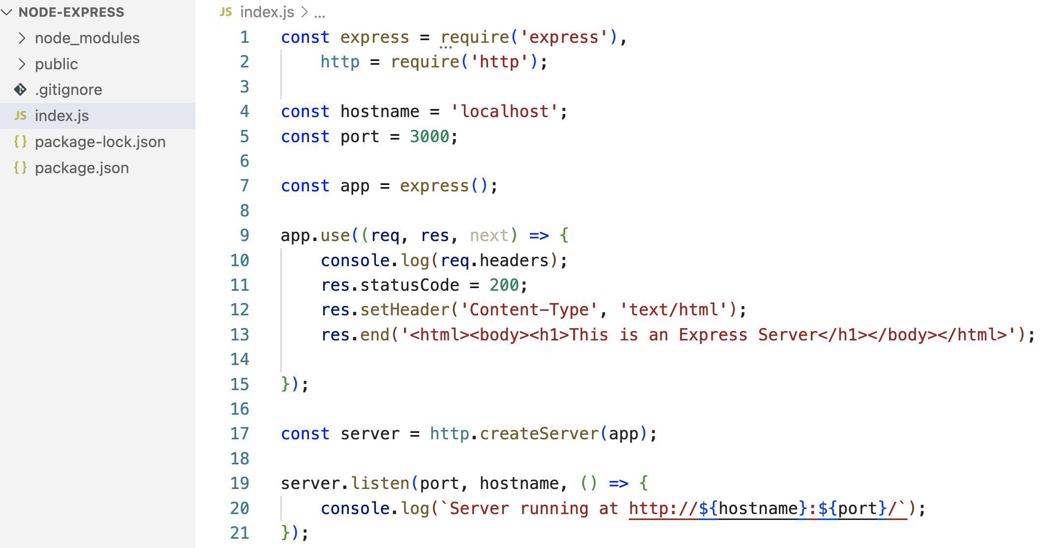
A Simple Server using Express
Create a file named index.js and add the following code to it:

Slide 12
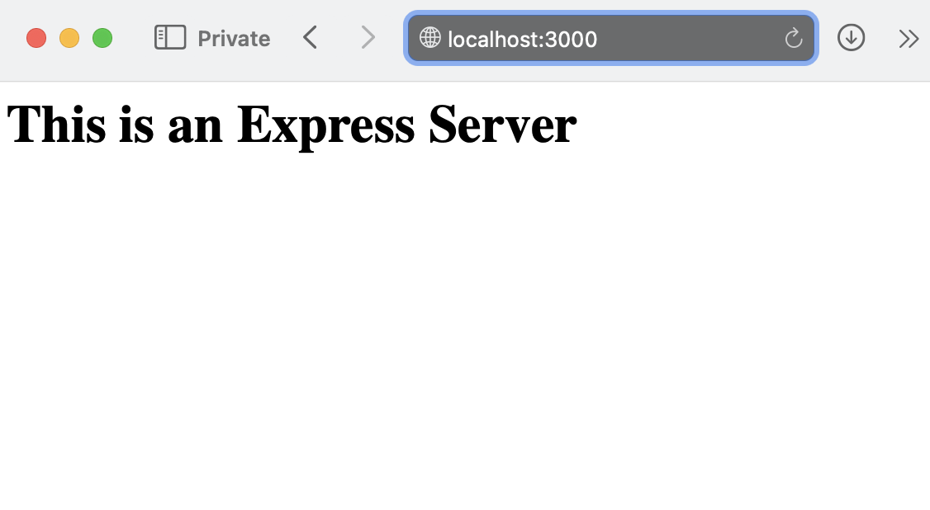
A Simple Server using Express
Start the server by typing the following at the prompt, and then interact with the server:
npm start

Slide 13
Express Router

Slide 14
Express Application Routes
We examined REST in the previous lecture
Identify an end point with a URI
Apply the verb on the URI
Express supports this through app.all, app.get, app.post, app.put, app.delete methods

Slide 15
Express Application Routes
Application Routes: app.all(‘/dishes’, function(req,res,next) { . . . });
app.get(‘/dishes’, function(req,res,next) { . . . }); app.post(‘/dishes’, function(req,res,next) { . . . }); app.put(‘/dishes’, function(req,res,next) { . . . }); app.delete(‘/dishes’, function(req,res,next) { . . . });

Slide 16
Routes with Parameters
Example: app.get(‘/dishes/:dishId’, (req,res,next) => {
res.end(‘Will send details of the dish: ’ + req.params.dishId + ‘ to you!’)
});

Slide 17
Body Parser
Middleware to parse the body of the message
Using Body Parser: var bodyParser = require('body-parser’); app.use(bodyParser.json()); // parse the JSON in the body
Parses the body of the message and populates the req.body property

Slide 18
Express Router
Express Router creates a mini-Express application:
var dishRouter = express.Router(); dishRouter.use(bodyParser.json());
dishRouter.route(‘/’)
.all(. . .);
.get(. . .);
...

Slide 19
Use application routes in the Express framework to support REST API

Slide 20
Setting up a REST API

Slide 21
Step by step
You will continue in the node-express folder and modify the server in this exercise.
Install body-parser by typing the following at the command prompt:
Update index.js file
npm install body-parser@1.18.3 --save
Notes:
https://expressjs.com/en/resources/middleware/body-parser.html

Slide 22
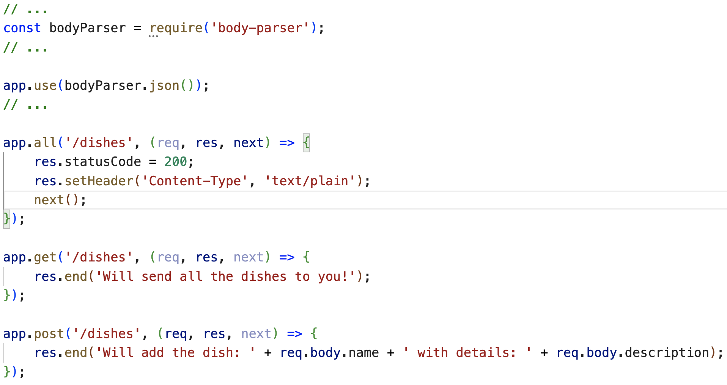
Update index.js file

Slide 23
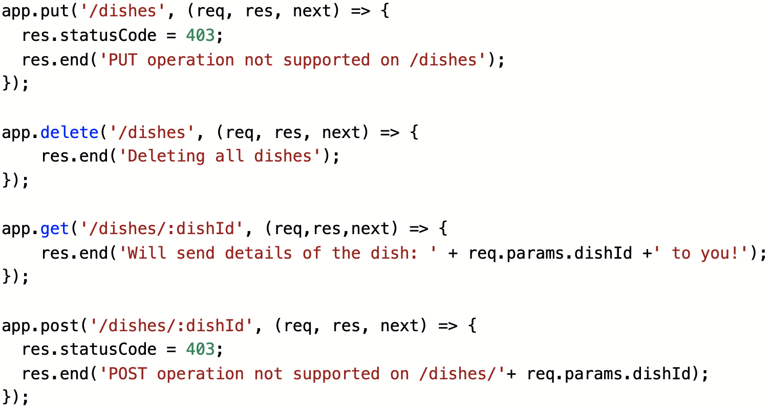
Update index.js file

Slide 24
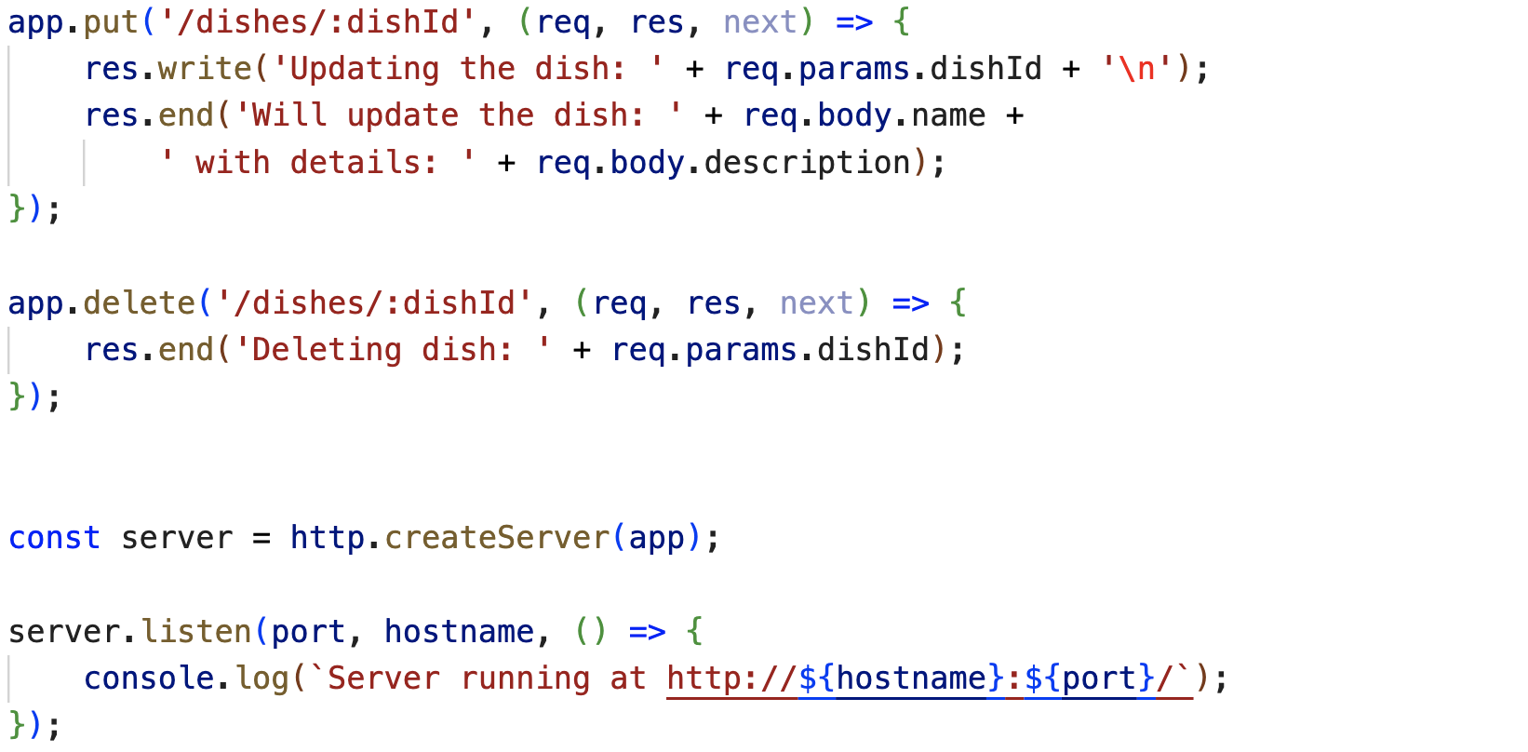
Update index.js file

Slide 25
Test REST API

Slide 26
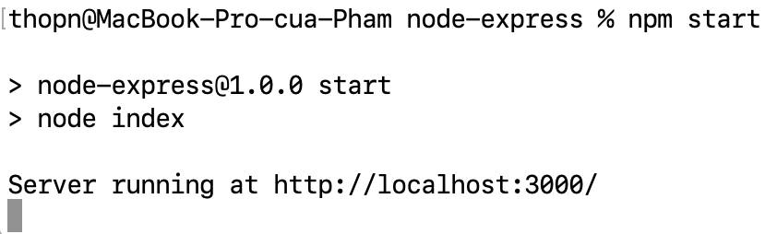
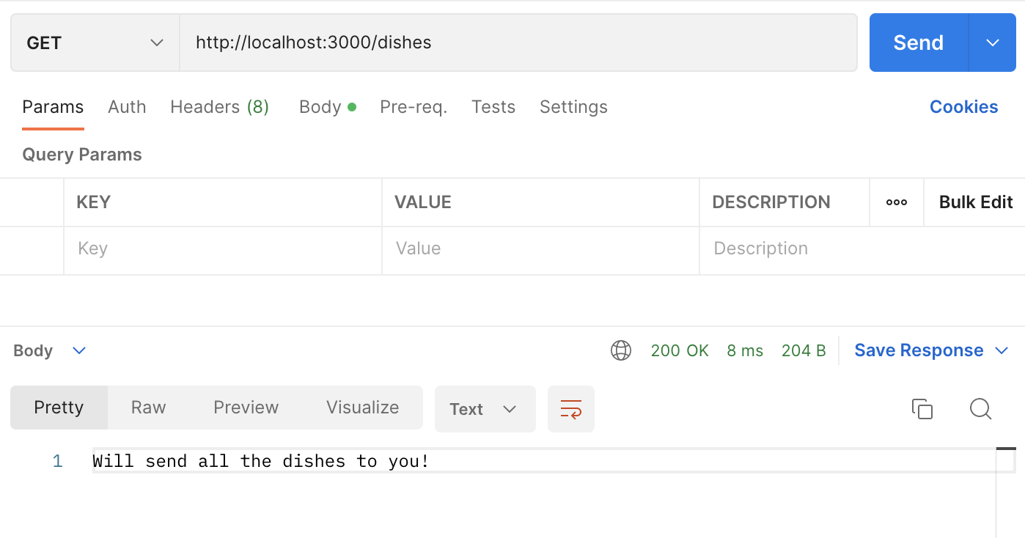
Test REST API
Start the server and interact with it from the postman
Send request to: /dishes
Method: GET

Slide 27
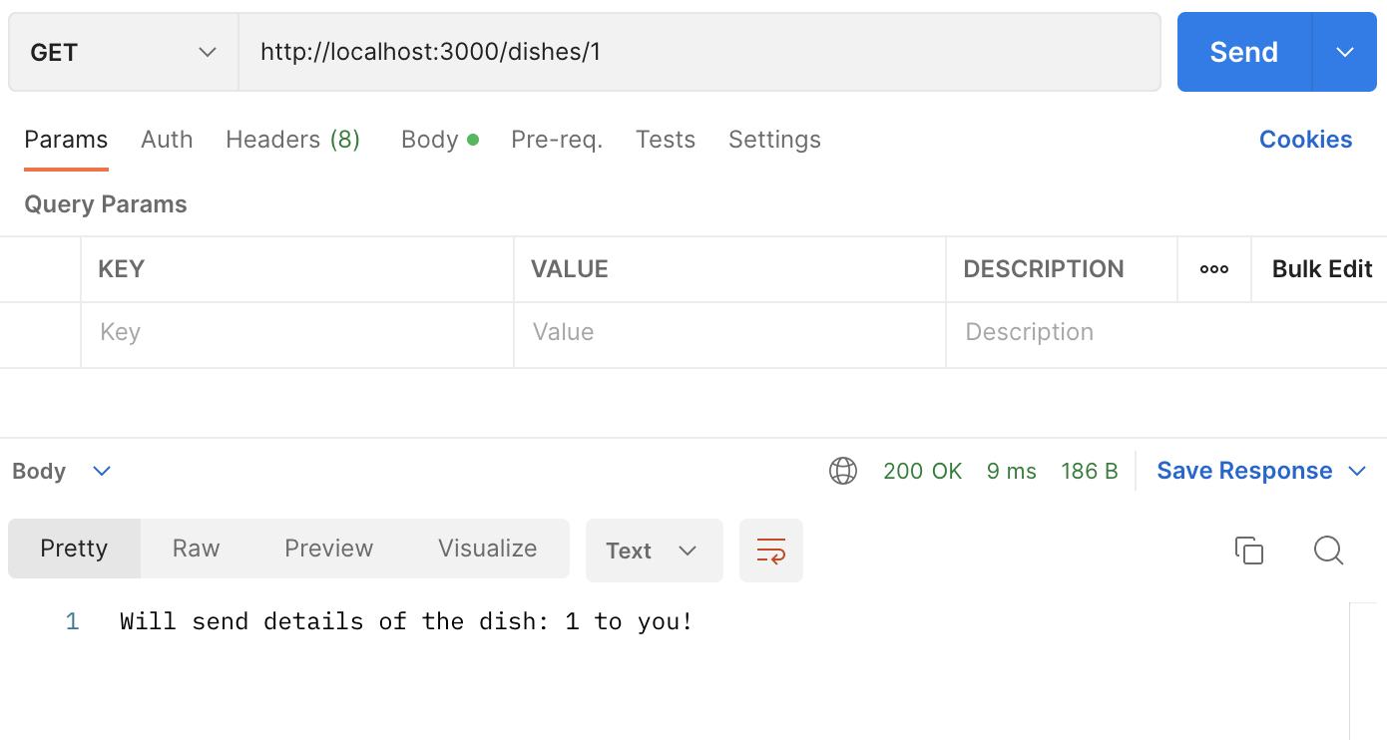
Test REST API
Send request to: /dishes/1
Method: GET

Slide 28
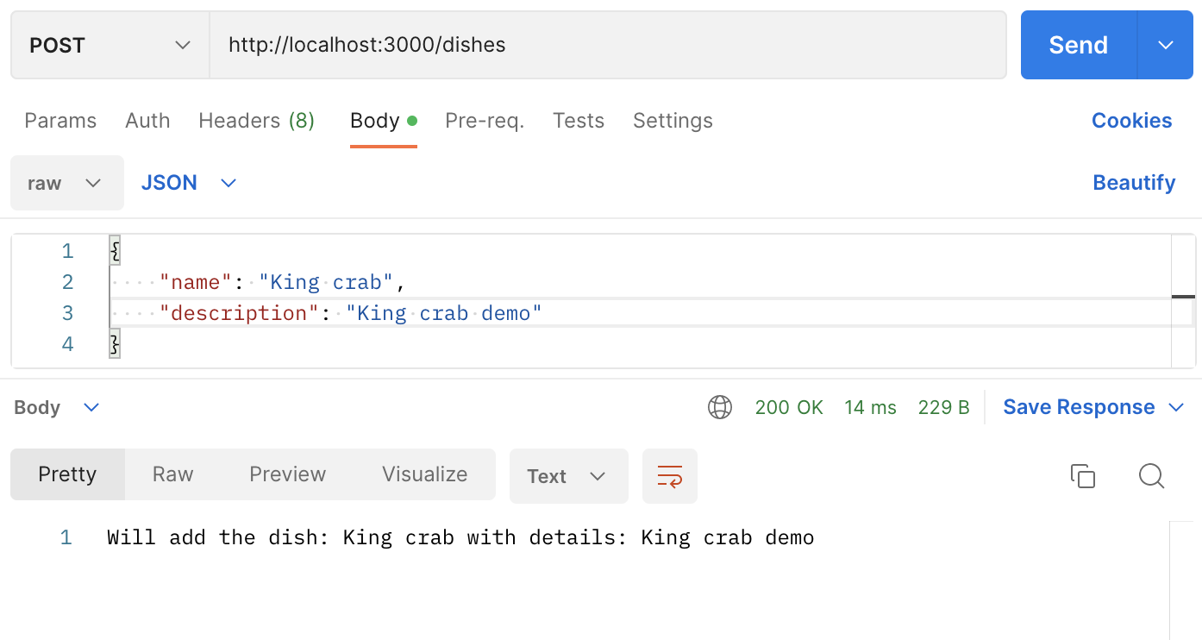
Test REST API
Send request to: /dishes
Method: POST
Body: text/json
{
“name”: King crab,
“description”: King crab demo
}

Slide 29
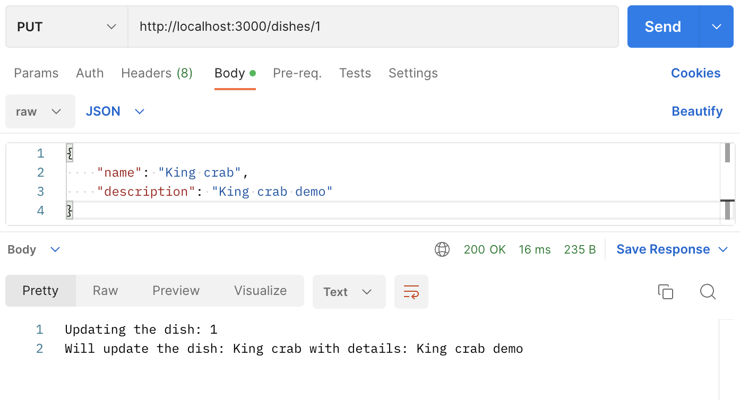
Test REST API
Send request to: /dishes/1
Method: PUT
Body: text/json
{
“name”: King crab,
“description”: King crab demo
}

Slide 30
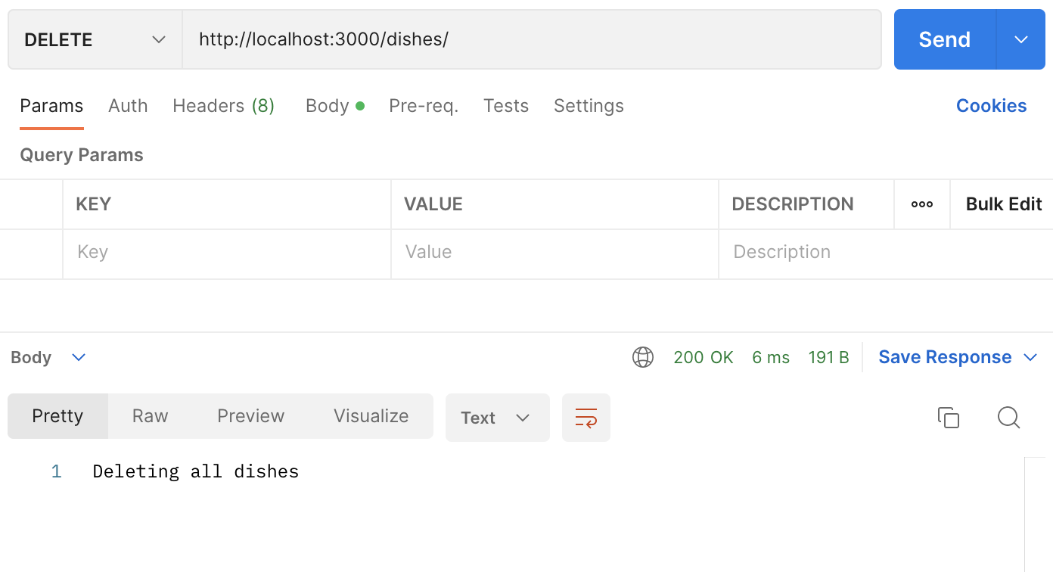
Test REST API
Send request to: /dishes
Method: DELETE

Slide 31
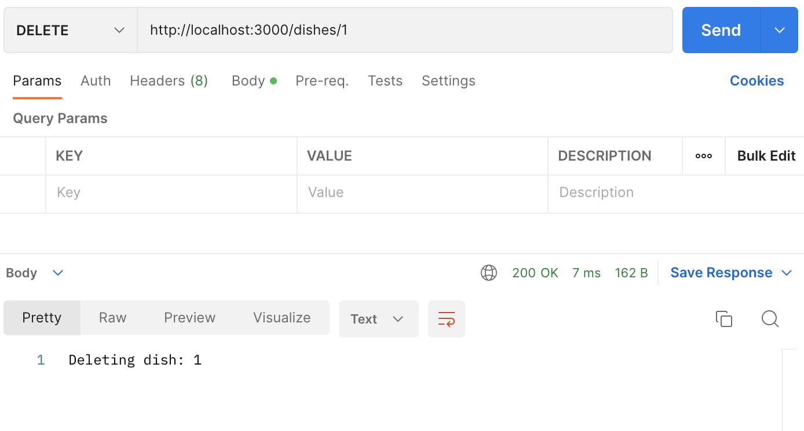
Test REST API
Send request to: /dishes/1
Method: DELETE

Slide 32
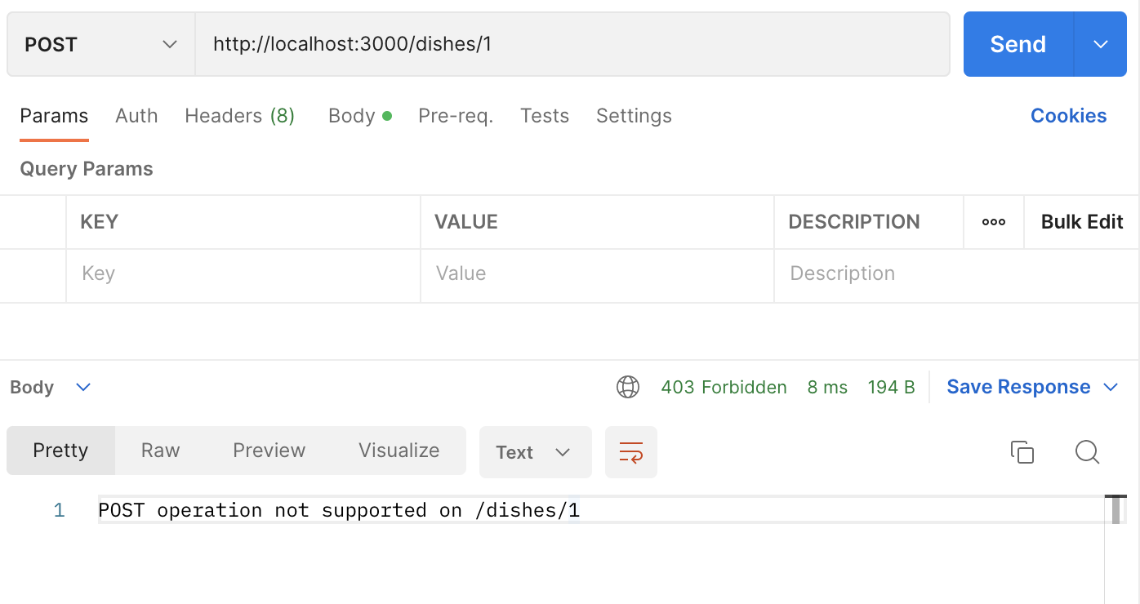
Test REST API
Send request to: /dishes/1
Method: POST

Slide 33
Use the Express Router in Express framework to support REST API

Slide 34
Using Express Router

Slide 35
Using Express Router
Create a new folder named routes in the node-express folder.
Create a new file named dishRouter.js in the routes folder and add the following code to it:

Slide 36
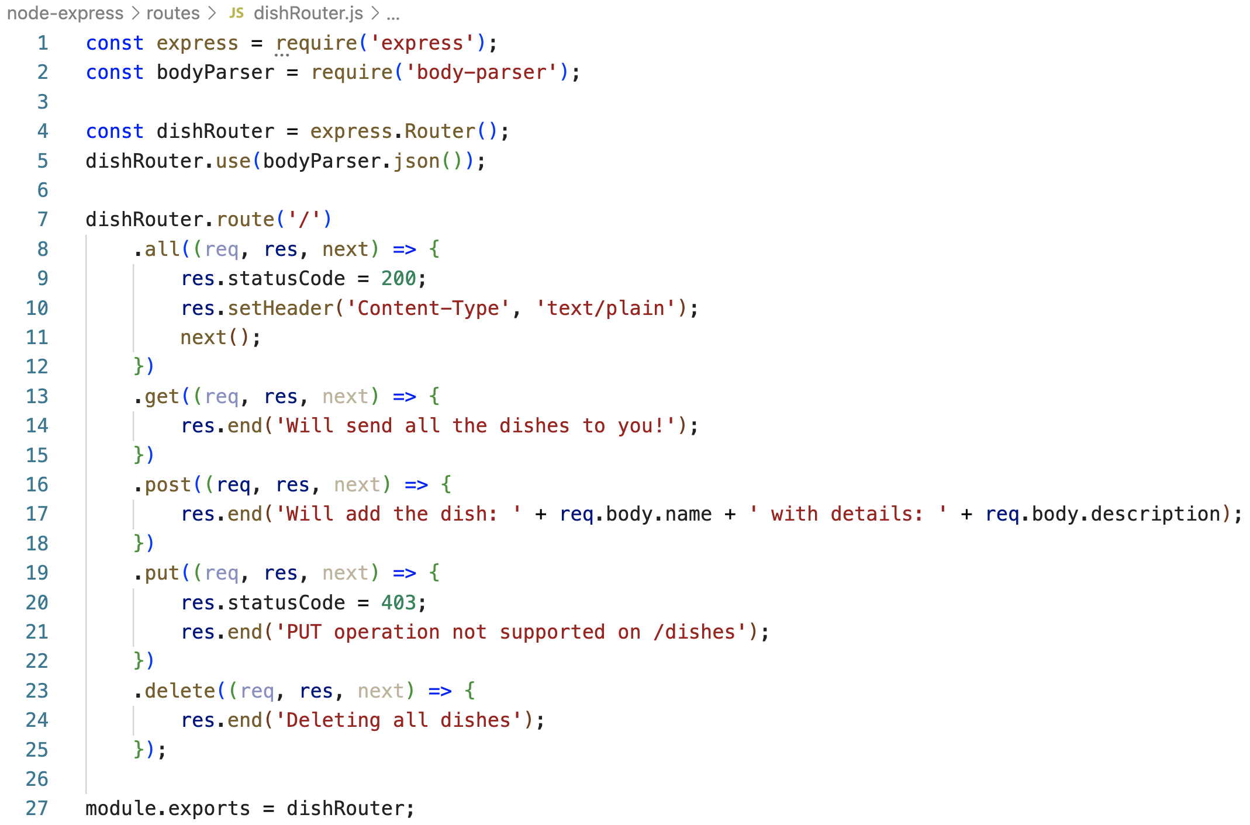
Using Express Router
dishRouter.js

Slide 37
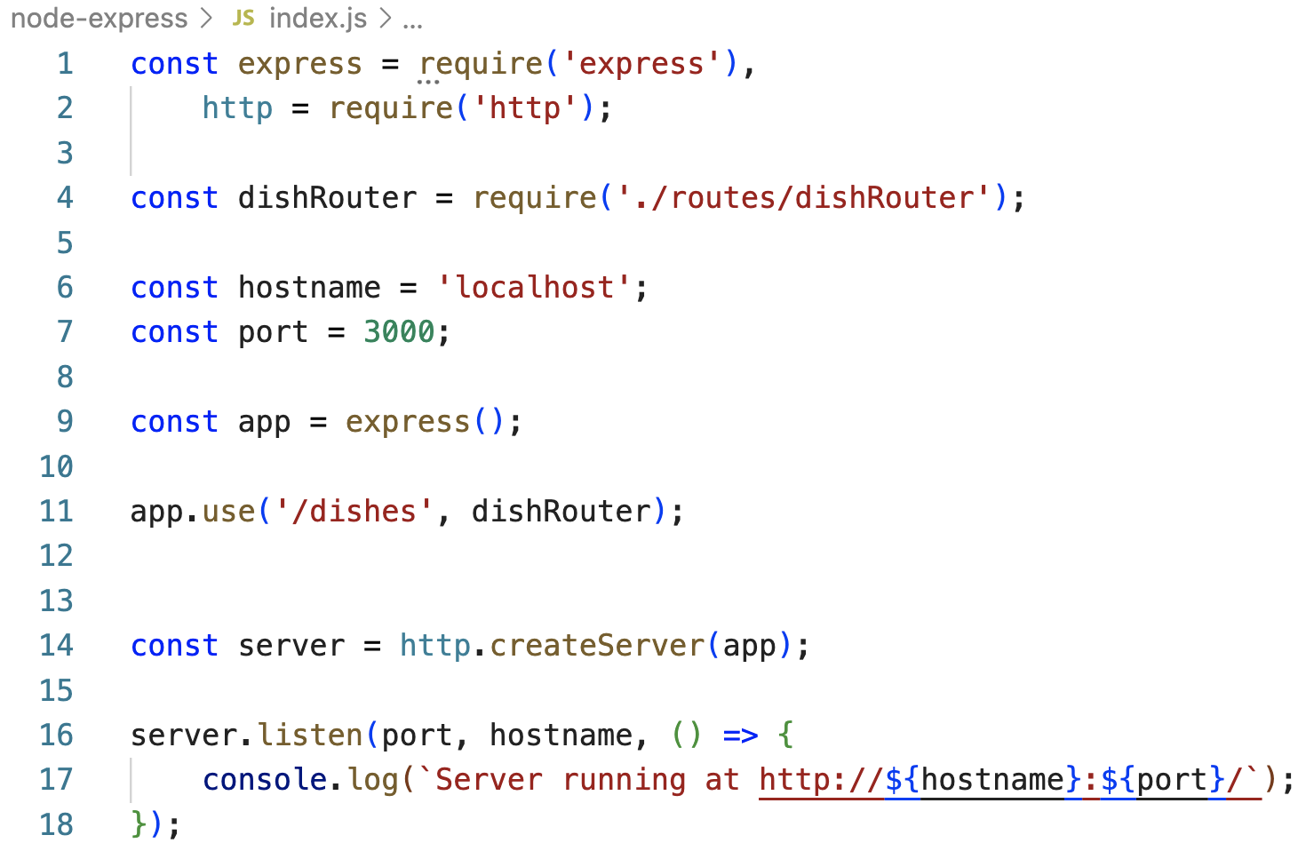
Using Express Router
Update index.js as follows:

Slide 38
Using Express Router
Start the server and interact with it from the postman
Send request to: /dishes
Method: GET

Slide 39
Summary
Understand the Express
Understand to implement a web server using the Express framework
Step by step develop a web server that supports a REST API
Understand to use Express router to implement support for the REST API

